Slide 1


Gastón Creci
07/03/2025
Disclaimer: this presentation is filled in from a template, following specific directions. If it was up to me, I wouldn’t clutter that much text and bullet points, and rather keep a simple style.

Slide 2

Outline
Executive Summary
Introduction
Methodology
Results
Conclusion
Appendix

Slide 3
Executive Summary
Summary of methodologies
Summary of all results

Slide 4
Introduction
Project background and context
Problems you want to find answers

Slide 5

Section 1

Slide 6
Methodology
Executive Summary
Data collection methodology:
Data is retrieved via SpaceX API and web scraping with BeatifulSoup, stored as a Dataframe, cleaned and specialized to the Falcon 9 launches.
Perform data wrangling
Data is cleaned, separated into numerical and categorical columns and classified according to the mission outcomes.
Perform exploratory data analysis (EDA) using visualization and SQL
Perform interactive visual analytics using Folium and Plotly Dash
Perform predictive analysis using classification models
How to build, tune, evaluate classification models

Slide 7
Data Collection
Data sets collected via
SpaceX API: JSON response
Web scraping: HTML response
Final pandas Dataframe with the parsed data

Slide 8
Data Collection – SpaceX API
After launching the SpaceX API, we extract the IDs of the rocket launches.
We use the IDs to extract the properties of each launch.
We build a Dataframe with the data and filter the Falcon 9 launches.
The file can be found here.
Launch SpaceX API
Use GET request
JSON response
Dataframe with IDs
Use API and IDs to parse and extract:
Booster Version
Launch Site
Payload
Core
Select Falcon 9 launches

Slide 9
Data Collection - Scraping
We use the Wikipedia page for Falcon 9 launches.
Using BeautifulSoup we parse the html and extract the relevant columns.
The file can be found here.
Web scraping
Use GET request from Falcon 9 Wikipedia
HTML response
BeautifulSoup object
Use html code to select tables, parse and extract:
Flight No - Orbit
Launch Site - Customer
Payload - Launch outcome
Payload mass - Booster Version
Booster landing outcome
Date - Time

Slide 10
Data Wrangling
First, we identify missing values in the landing pad column, as well as identify data types.
Afterwards, we explore the launches sites and orbit types of each launch, and find that most of the rockets are launched at CCAFS SLC 40, and to a GTO orbit.
Using the outcomes, we identify the successful and unsuccessful landings, and transform their values into numerical Booleans (0/1) for feature engineering.
The file can be found here
EDA:
Identify missing values
EDA:
launch sites and orbits
Training labels:
Outcomes
0
1

Slide 11
EDA with Data Visualization
We plotted the following relationships due to their possible correlation with the landing outcome:
Payload mass, launch site, and flight number.
Success rate, orbit type, payload mass, and flight number.
Launch success yearly trend.
The file can be found here

Slide 12
EDA with SQL
The SQL queries we performed were to obtain:
The names of the unique launch sites.
5 records where launch sites begin with ‘CCA’
The total payload mass carried by boosters launched by NASA (CRS)
The average payload mass carried by booster version F9 v1.1.
The date when the first successful landing outcome in a ground pad was archived.
The names of the boosters which succeeded in a drone ship and have a payload mass between 4 and 6 tones.
Total number of successful and failure mission outcomes
The names of the booster versions that carried the maximum payload mass
The month names, failure landing outcomes in a drone shup, booster versions and launch sites for the year 2015.
The ranked count of landing outcomes between the data 04/06/2010 and 20/03/2017.
The file can be found here

Slide 13
Build an Interactive Map with Folium
We created a Folium map centered at NASA Johnson Space Center (NJSC) at Houston, TX. Using the map objects circle and marker, we added a circle around NJSC and the other launch sites within the data set, and a label (marker) displaying the name of the site.
Within each launch, we added a marker cluster object to show the outcome of the landing (success/failure), indicated by the color in the customized icons.
Finally, we study the proximity of the launch sites to cities, railways, highways and costal lines by drawing a PolyLine and computing the distance to each item using MousePosition.
The file can be found here

Slide 14
Build a Dashboard with Plotly Dash
After selecting a launch site or all of them using a dropdown menu, we made a dashboard displaying:
Pie chart with total success landings corresponding to all sites
Pie chart with success rate specialized to a specific site.
Additionally, we plot the successes and failures for the different booster version categories, as a function of the payload mass, which range is controlled by a slider.
By studying these plots, we can study the optimum site launch, booster category version and payload mass in order to have a successful outcome.
The file can be found here

Slide 15
Predictive Analysis (Classification)
We identify the target variable as class, this is, the outcome of the landing.
After standardizing the data, we split it into train and test data, with the test size being a 20% of the total.
Then, we performed a grid search to look for the best parameters for:
Logistic regression
Support vector machine
And evaluated their scores via:
Accuracy on train data
Accuracy on test data
Confusion matric
The file can be found here
Decision tree
K-nearest neighbors

Slide 16
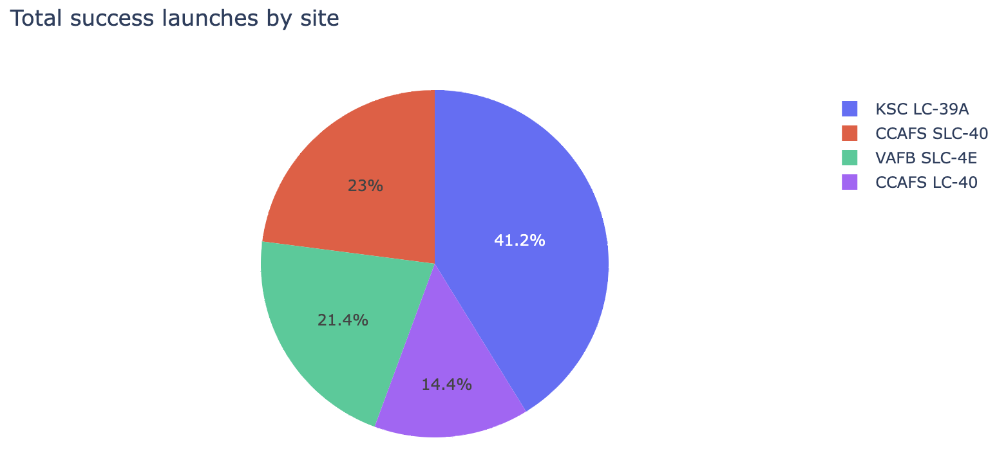
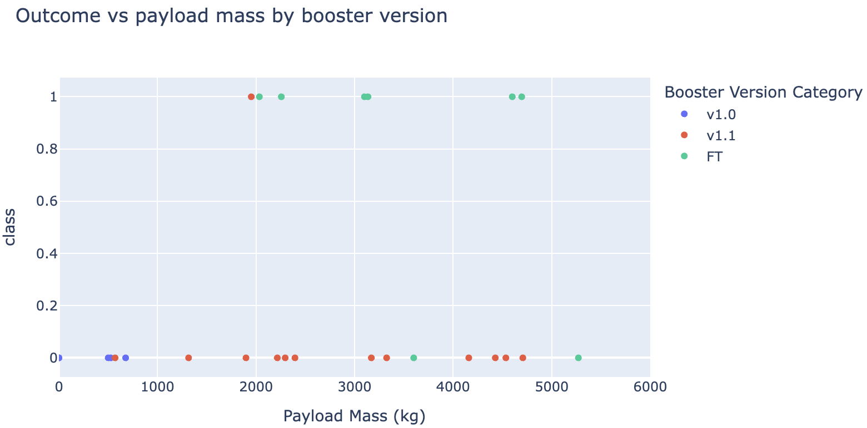
Results
EDA Visualization
The outcome is skewed within each launch site
Most of the failed launches are in CCAFS SLC 40
KSL LC 39A has the higher success rate
Launches with heavier payload masses are mostly successful
The most successful orbits are ES-L1, GEO, HEO and SSO.
The success in the LEO orbit seems to be related to the number of flights, although is not the case for the GTO orbit
Heavy payloads are more successful in the LEO, ISS and PO orbits.
The success rate has been increasing since 2013.
EDA SQL
Total payload mass carried by boosters launched by NASA (CRS) is 48213 Kg
The average payload mass carried by booster version F9 v1.1 is 2534.66 Kg
The first successful landing outcome in ground pad was archived on the 22/12/2015.
There is a total of 61 successful missions and 10 failed missions.
The most successful orbits are ES-L1, GEO, HEO and SSO.
The most landing outcomes are using a drone ship, and the least are the parachute landing.

Slide 17
Results
The predictive analysis revealed that the best model to predict the landing outcomes is a Decision Tree with:
Criterion: ‘gini’
Max_depth: 6
Max_features=‘sqrt’
Overall reaching the most accuracy of all models with a value of 0.88.
Min_samples_split: 10
Splitter: random

Slide 18

Section 2

Slide 19
Flight Number vs. Launch Site
Show a scatter plot of Flight Number vs. Launch Site
Show the screenshot of the scatter plot with explanations

Slide 20
Payload vs. Launch Site
Show a scatter plot of Payload vs. Launch Site
Show the screenshot of the scatter plot with explanations

Slide 21
Success Rate vs. Orbit Type
Show a bar chart for the success rate of each orbit type
Show the screenshot of the scatter plot with explanations

Slide 22
Flight Number vs. Orbit Type
Show a scatter point of Flight number vs. Orbit type
Show the screenshot of the scatter plot with explanations

Slide 23
Payload vs. Orbit Type
Show a scatter point of payload vs. orbit type
Show the screenshot of the scatter plot with explanations

Slide 24
Launch Success Yearly Trend
Show a line chart of yearly average success rate
Show the screenshot of the scatter plot with explanations

Slide 25
All Launch Site Names
Find the names of the unique launch sites
Present your query result with a short explanation here

Slide 26
Launch Site Names Begin with 'CCA'
Find 5 records where launch sites begin with `CCA`
Present your query result with a short explanation here

Slide 27
Total Payload Mass
Calculate the total payload carried by boosters from NASA
Present your query result with a short explanation here

Slide 28
Average Payload Mass by F9 v1.1
Calculate the average payload mass carried by booster version F9 v1.1
Present your query result with a short explanation here

Slide 29
First Successful Ground Landing Date
Find the dates of the first successful landing outcome on ground pad
Present your query result with a short explanation here

Slide 30
Successful Drone Ship Landing with Payload between 4000 and 6000
List the names of boosters which have successfully landed on drone ship and had payload mass greater than 4000 but less than 6000
Present your query result with a short explanation here

Slide 31
Total Number of Successful and Failure Mission Outcomes
Calculate the total number of successful and failure mission outcomes
Present your query result with a short explanation here

Slide 32
Boosters Carried Maximum Payload
List the names of the booster which have carried the maximum payload mass
Present your query result with a short explanation here

Slide 33
2015 Launch Records
List the failed landing_outcomes in drone ship, their booster versions, and launch site names for in year 2015
Present your query result with a short explanation here

Slide 34
Rank Landing Outcomes Between 2010-06-04 and 2017-03-20
Rank the count of landing outcomes (such as Failure (drone ship) or Success (ground pad)) between the date 2010-06-04 and 2017-03-20, in descending order
Present your query result with a short explanation here

Slide 35

Section 3

Slide 36
<Folium Map Screenshot 1>
Replace <Folium map screenshot 1> title with an appropriate title
Explore the generated folium map and make a proper screenshot to include all launch sites’ location markers on a global map
Explain the important elements and findings on the screenshot

Slide 37
<Folium Map Screenshot 2>
Replace <Folium map screenshot 2> title with an appropriate title
Explore the folium map and make a proper screenshot to show the color-labeled launch outcomes on the map
Explain the important elements and findings on the screenshot

Slide 38
<Folium Map Screenshot 3>
Replace <Folium map screenshot 3> title with an appropriate title
Explore the generated folium map and show the screenshot of a selected launch site to its proximities such as railway, highway, coastline, with distance calculated and displayed
Explain the important elements and findings on the screenshot

Slide 39

Section 4

Slide 40
<Dashboard Screenshot 1>
Replace <Dashboard screenshot 1> title with an appropriate title
Show the screenshot of launch success count for all sites, in a piechart
Explain the important elements and findings on the screenshot

Slide 41
<Dashboard Screenshot 2>
Replace <Dashboard screenshot 2> title with an appropriate title
Show the screenshot of the piechart for the launch site with highest launch success ratio
Explain the important elements and findings on the screenshot

Slide 42
<Dashboard Screenshot 3>
Replace <Dashboard screenshot 3> title with an appropriate title
Show screenshots of Payload vs. Launch Outcome scatter plot for all sites, with different payload selected in the range slider
Explain the important elements and findings on the screenshot, such as which payload range or booster version have the largest success rate, etc.

Slide 43

Section 5

Slide 44
Classification Accuracy
Visualize the built model accuracy for all built classification models, in a bar chart
Find which model has the highest classification accuracy

Slide 45
Confusion Matrix
Show the confusion matrix of the best performing model with an explanation

Slide 46
Conclusions
Point 1
Point 2
Point 3
Point 4
…

Slide 47
Appendix
Include any relevant assets like Python code snippets, SQL queries, charts, Notebook outputs, or data sets that you may have created during this project

Slide 48


